Slide 1


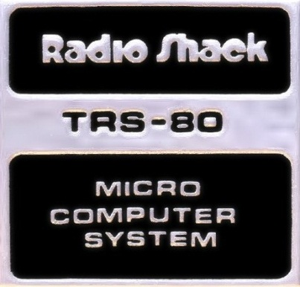
The History of the
Home Computer
– Part 1
“The 1977 Trinity”

Slide 2
The History of the
Home Computer
– Part 1
“The 1977 Trinity”

Slide 3
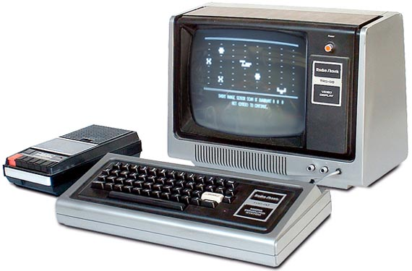
“The 1977 Trinity”

Slide 4
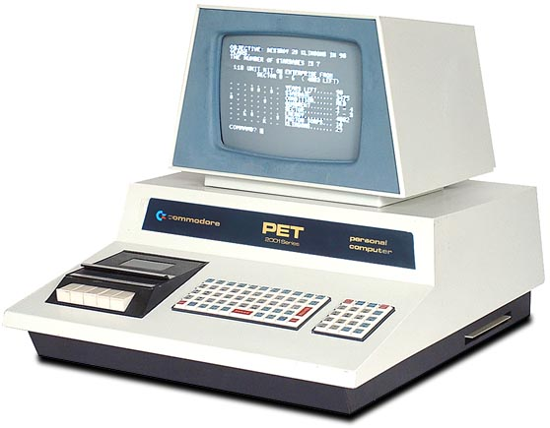
“The 1977 Trinity”
Notes:
Announced January, shipped October

Slide 5
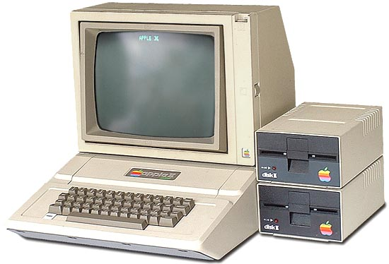
“The 1977 Trinity”

Slide 6
A little bit about me…

Slide 7
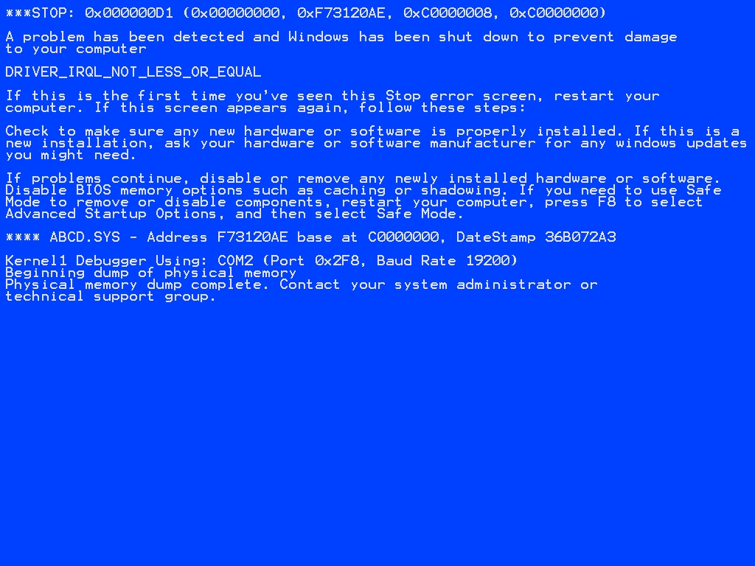
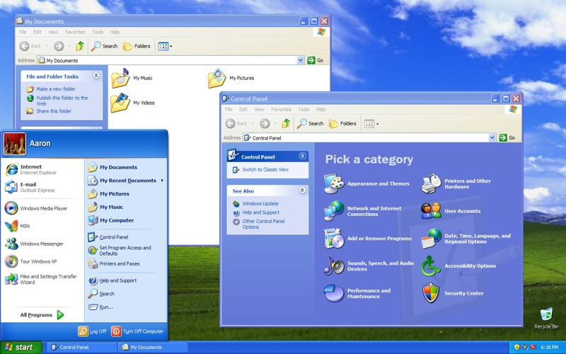
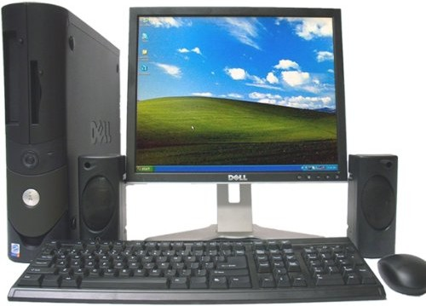
2003
Notes:
Compaq Deskpro
Omni 3
Anonymous beige boxes

Slide 8
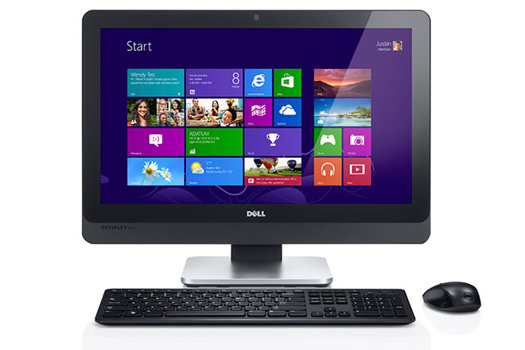
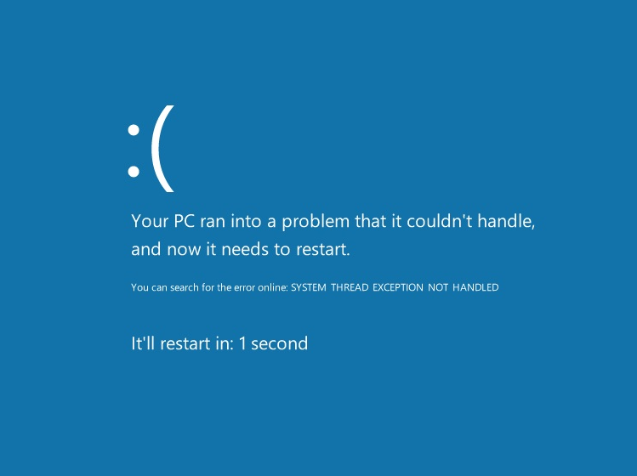
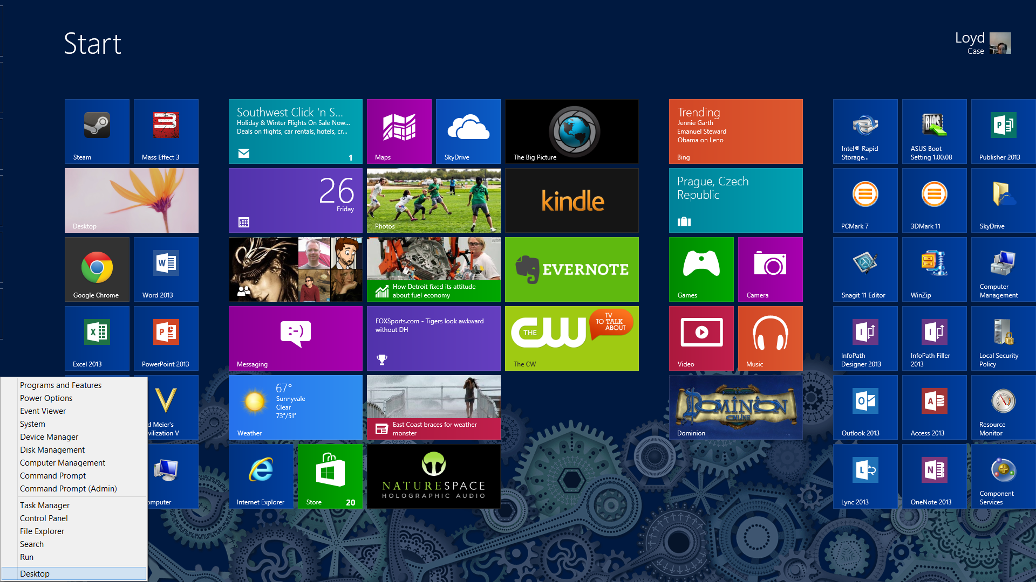
2013
Notes:
Compaq Deskpro
Omni 3
Anonymous beige boxes

Slide 9
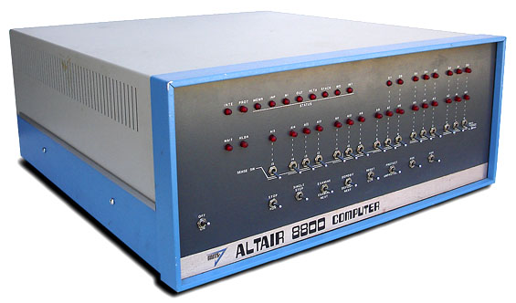
1975 – MITS Altair 8800
Notes:
Micro Instrumentation and Telemetry Systems (MITS)
Introduced:January 1975, Available:February 1975
Prices:US $395 as a kit(prior to March)US $650 assembled
How many:estimated 2000+
CPU:Intel 8080, 2.0 MHz RAM:256 bytes, 64K max Display:front panel LEDs Controls:front panel switches
Expansion:Altair-bus card-cage Storage:paper tape, cassette orfloppy drive
OS:CP/M, BASIC
First Computer which Bill Gates & Paul Allen wrote commercial software

Slide 10
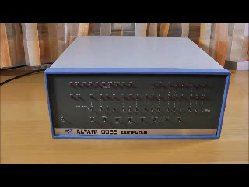
1975 – MITS Altair 8800
Intel 8080 CPU
256 Bytes Memory
Front Panel Switches
“Blinkenlichten!”
Basic on paper tape
Notes:
Micro Instrumentation and Telemetry Systems (MITS)
Introduced:January 1975, Available:February 1975
Prices:US $395 as a kit(prior to March)US $650 assembled
How many:estimated 2000+
CPU:Intel 8080, 2.0 MHz RAM:256 bytes, 64K max Display:front panel LEDs Controls:front panel switches
Expansion:Altair-bus card-cage Storage:paper tape, cassette orfloppy drive
OS:CP/M, BASIC
First Computer which Bill Gates & Paul Allen wrote commercial software

Slide 11

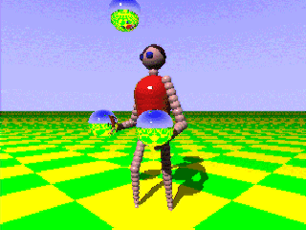
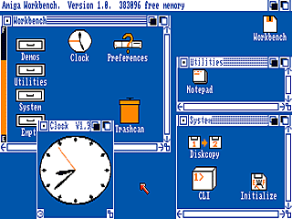
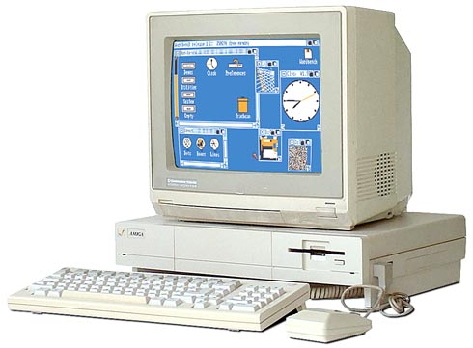
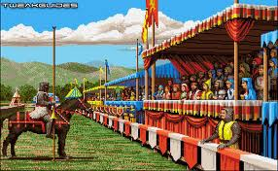
1985 -
Notes:
Ship Date:July 1985
Price:US $1295 without monitorUS $1790 with RGB monitor
CPU:Motorola 68000 @ 7.14 MHz
RAM:256K stock, 512 typical - 8Meg max.
Display:16 colors at 640 X 400, 4096 colors at 320 X 200
Ports:Parallel, serial, floppy, RGB, RF, composite videoStereo audio, joysticks, System bus
Storage:Internal 880K 3.5-inch floppy.
OS:AmigaDOS 1.0-1.34"Workbench" GUI

Slide 12
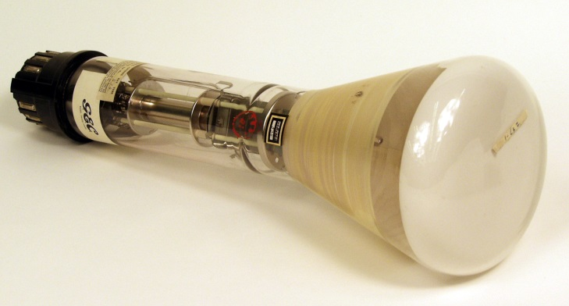
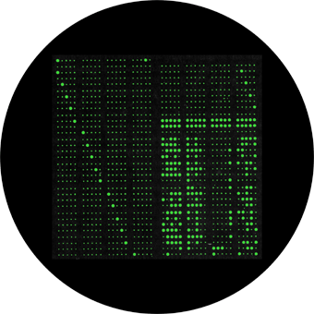
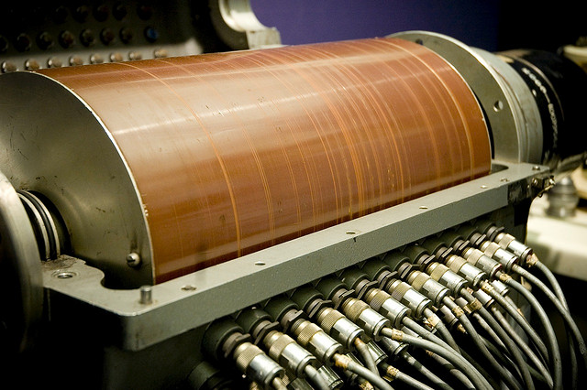
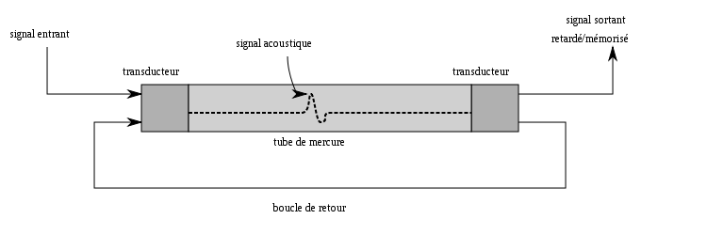
Driving the Revolution (1) - Memory
Early mechanical memories
  The Williams-Kilburn Tube
  Delay Line Memory
  Drum Memory

Slide 13
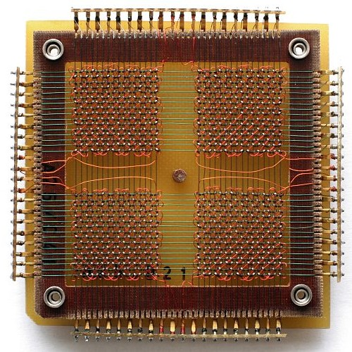
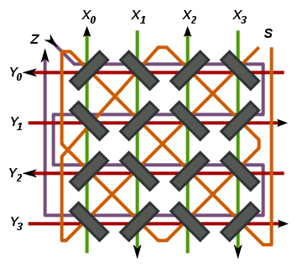
Driving the Revolution (1) - Memory
Magnetic Core Memory - 1951
Notes:
1024 bits – 32 x 32, made by hand

Slide 14
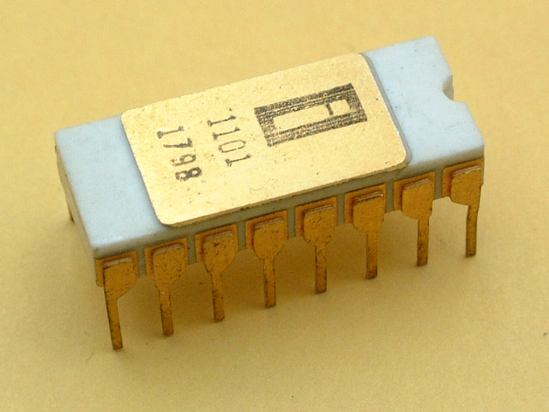
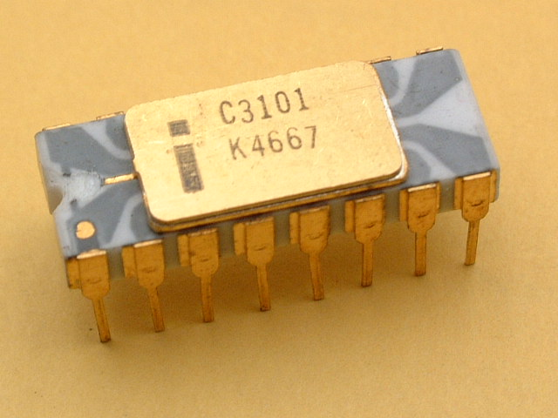
Driving the Revolution (1) - Memory
Semiconductor Memory – Static RAM
Intel started in 1968
Targeted market of LSI technology
Intel 3101
  1969, first successful product
  64 bit Static RAM
Intel 1101
  Late 1969
  256-bit Static RAM
  First use of MOS for RAM
  First high volume
  semiconductor RAM
Notes:
http://www.cpu-zone.com/RAM_History.htm
1024 bits – 32 x 32, made by hand

Slide 15
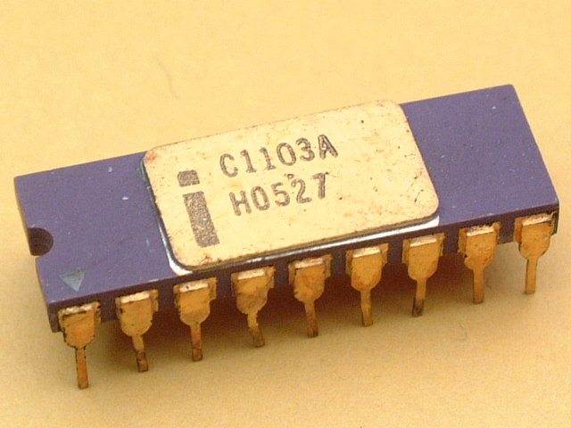
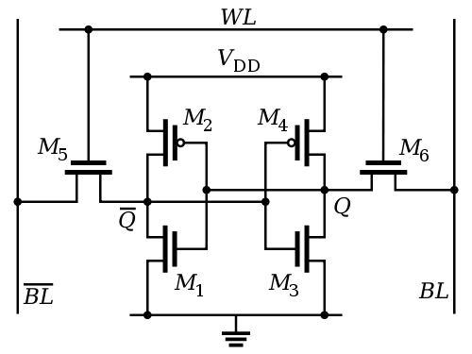
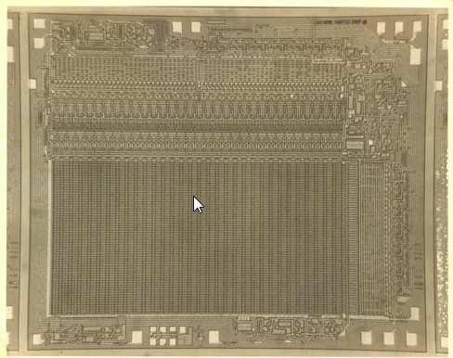
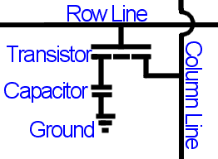
Driving the Revolution (1) - Memory
Disadvantages of Static RAM
Dynamic RAM (DRAM)
  Simpler to build
  Higher Densities
  Controlling it is more difficult
Intel 1103
  First commercial DRAM
  October 1970
  1024 x 1 bits
  By 1972, largest selling semiconductor
MOSTEK MK4096
  First multiplexed DRAM, 1973
  4096 x 1
Followed by MK4116
  1976
  16k x 1
  75% DRAM Market by end of 1979
Notes:
1024 bits – 32 x 32, made by hand

Slide 16
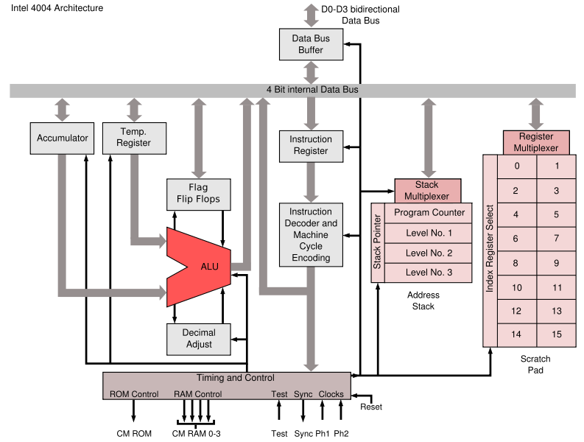
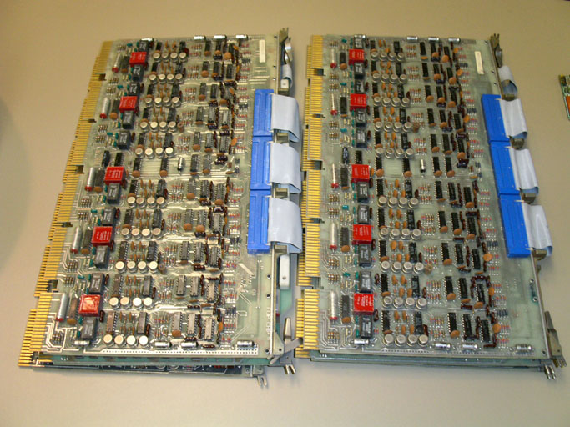
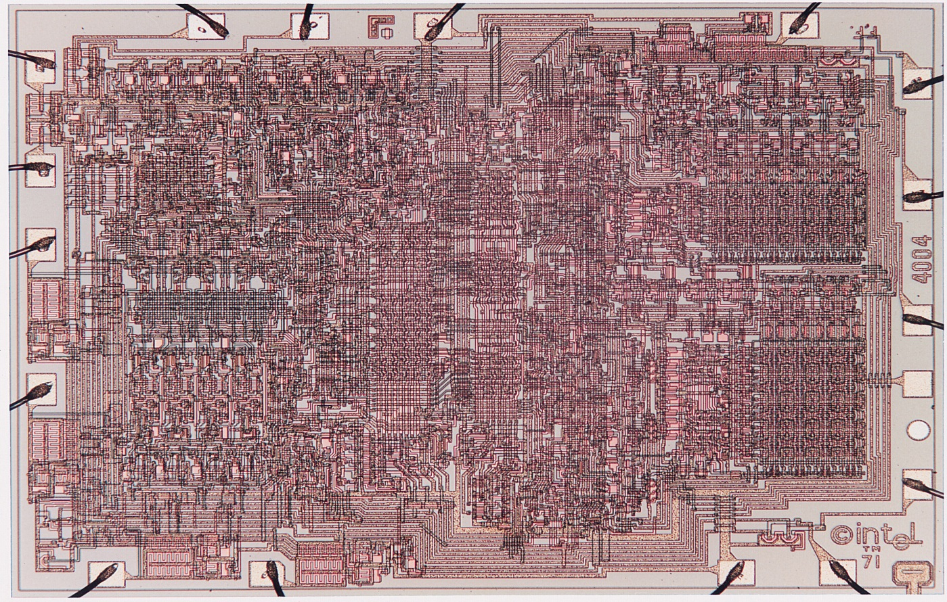
Driving the Revolution (2) – Microprocessors
During 1960’s CPU consisted of 10’s -> 100’s
discrete transistors.
Microprocessor integrates into a single piece of silicon, i.e. Integrated Circuit
Notes:
CADC – U.S. – avionics control for the F14 Tomcat - ??? Secret until 1998 - Ray Holt
4004 – first commercial, used for calculators – 2,300 transistors, 0.1 mhz

Slide 17

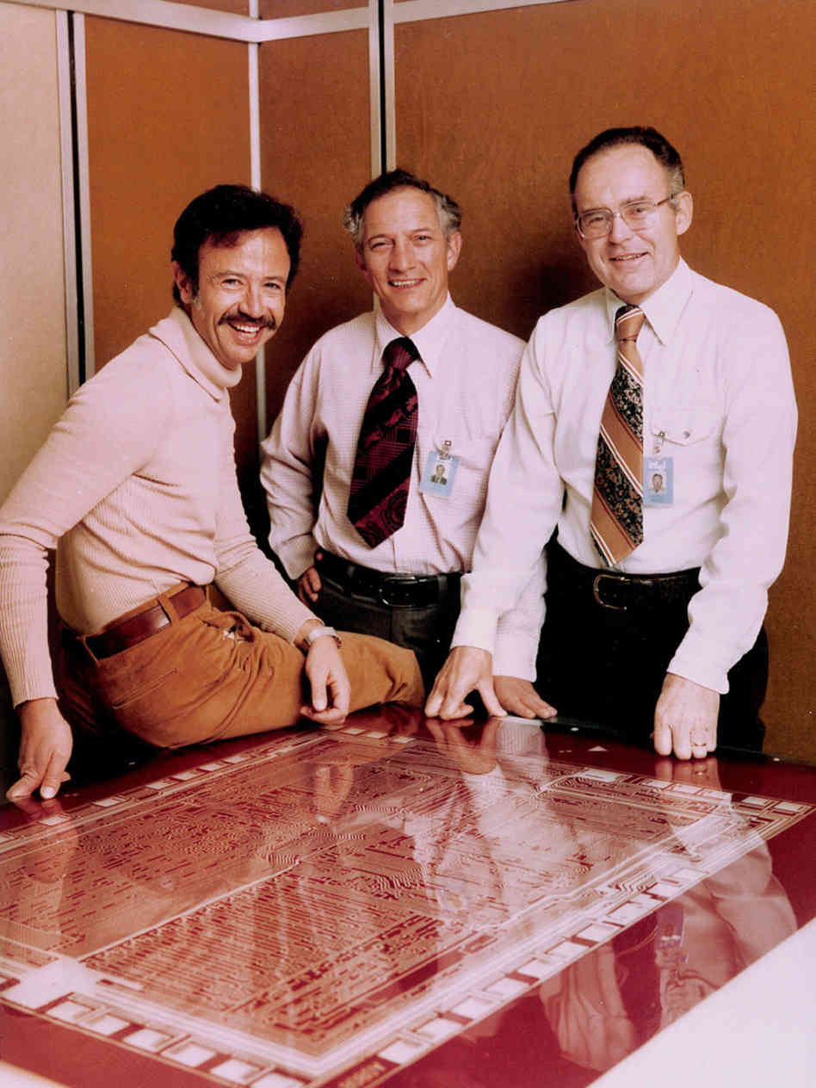
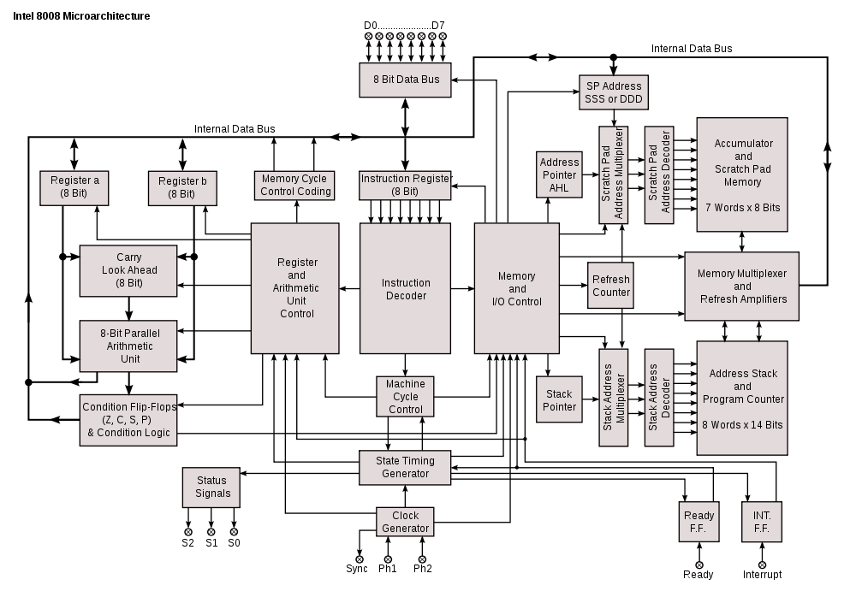
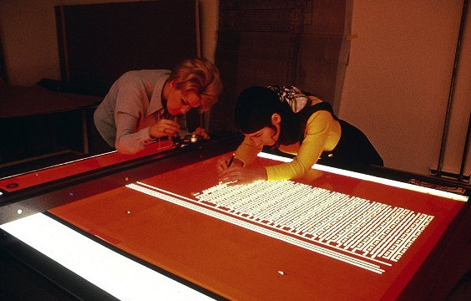
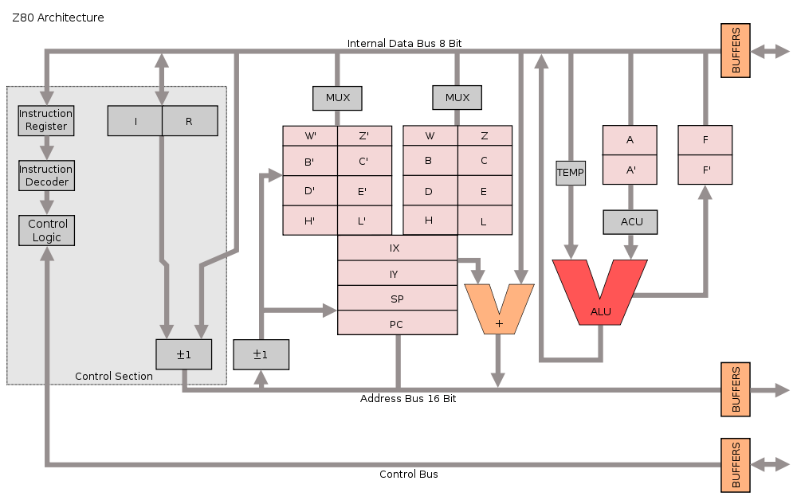
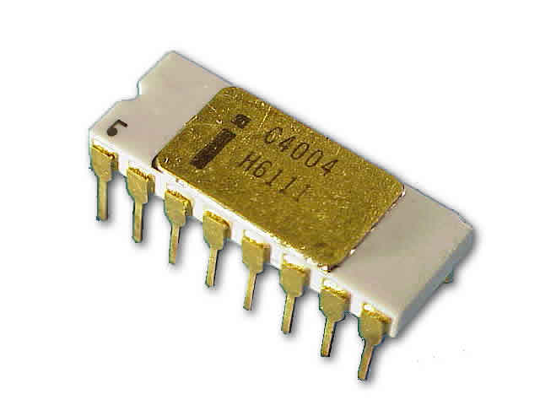
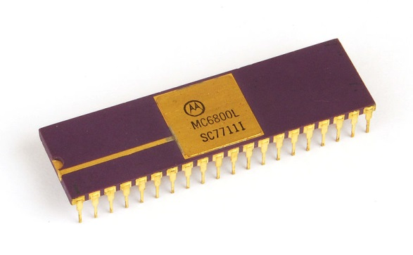
Driving the Revolution (2) – Microprocessors
CADC
Intel 4004
Intel 8008
Intel 8080
Zilog Z80
Motorola 6800
Notes:
CADC – Central Air Data Computer – 1968 -> 1970 - Avionics control for the F14 Tomcat - Secret until 1998 - Ray Holt
Intel 4004 – 4 bit – 1971 - first commercial $60, used for calculators – 2,300 transistors, 0.1 - 0.7 mhz
Intel 8008 – early 8 bit – 1972 - $120 –
Intel 8080 – 2nd intel 8-bit – 1974 - $360 - 16-bit address bus, 64k ram – Blinkin Lights & CP/M - machines – 2 -3 mhz – CISC long instructutions – up to 11 cycles – Andy Grove, Robert Noyce and Gordon Moore – Rubylith
Zilog Z80 – Federico Fagin left after 8080 – founded Zilog 1974 – binary compatible –(CPM) simpler architecture – TRS80, sinclair zx-80, spectrum) – still used today in embedded systems
Motorola 6800 – 8-bit, 16-bit address bus – 1974 - $360 single unit - family of support chips (cpu, ram, rom, pia) – design team left…

Slide 18

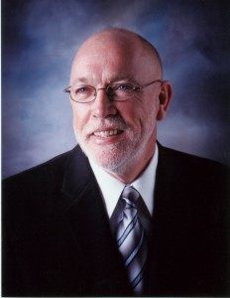
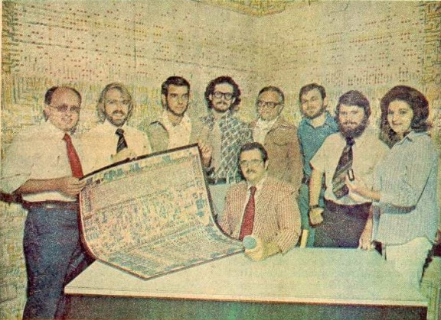
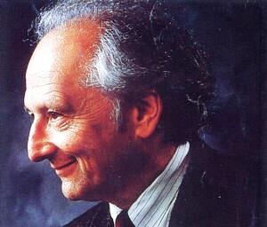
6502
Notes:
cheap Microprocessor, Motorola not interested
6800 team - Peddle - joined MOS Technology 1975
6501 - lawsuit
Mask Fixing – 30 -> 70% yield
6502 – RISC – 1mhz but instruction cycles
1975 trade show – vases of chips
Complete Product family
Kim-1
Uses PET, Apple 1 & 2, BBC Micro, Nintendo Entertainment System
Layout – crawling on tables - Visual 6502 – 3,510 transistors
Wilbur Mathys, Bill Mensch, Rodney Orgil, Ray Hirt, Chuck Peddle, Harry Bawcom, Michael Jaynes, Sydney-Anne Holt
,

Slide 19
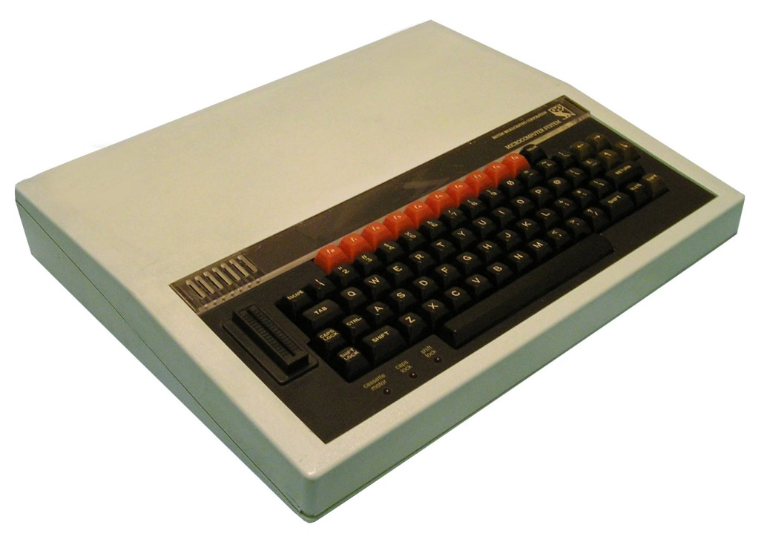
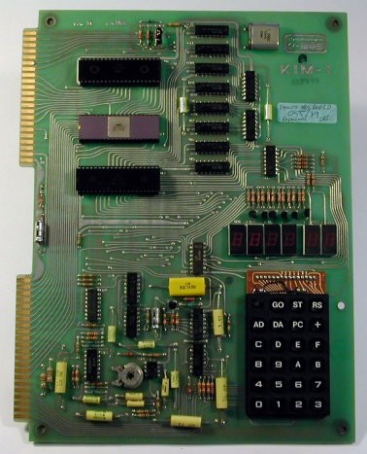
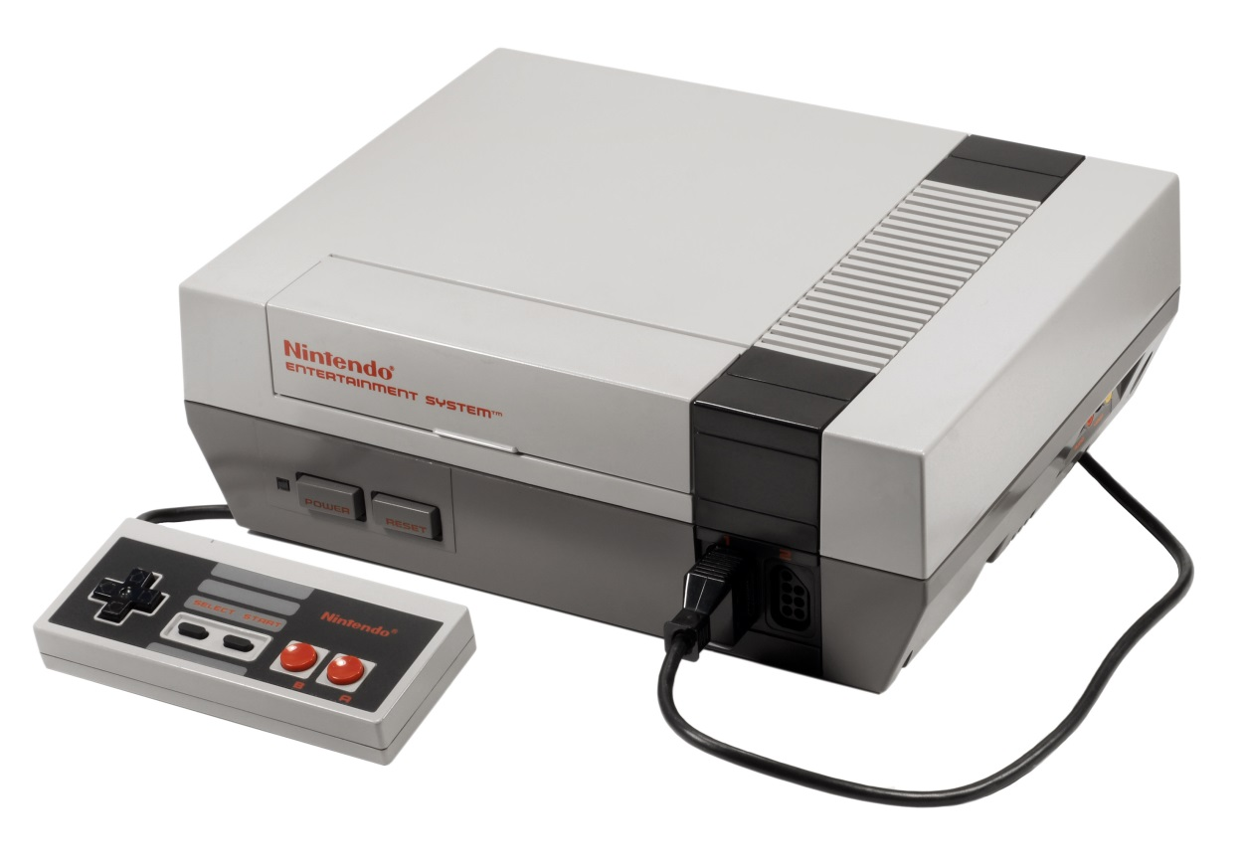
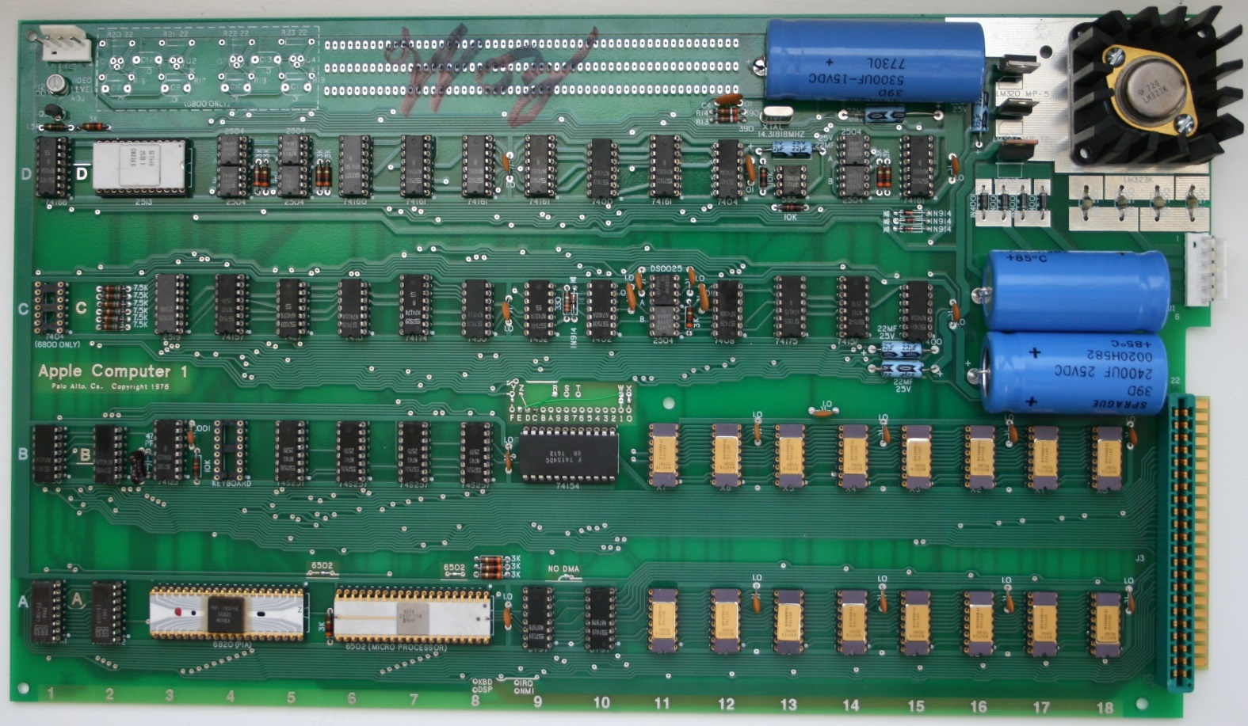
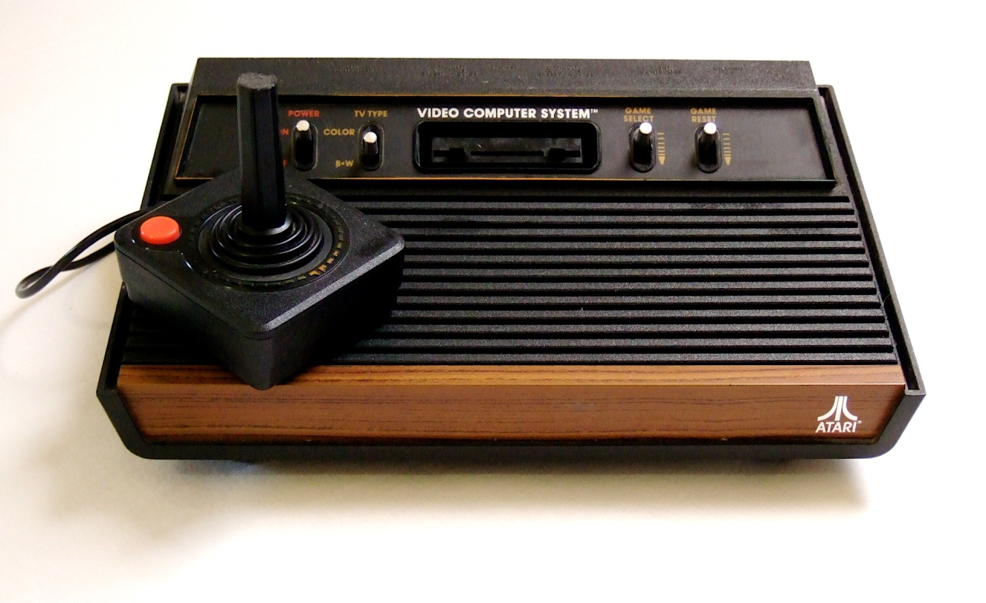
6502
8-bit Commodores
Apple 1 & ][
BBC Micro
Nintendo NES
Atari 2600 (6507)
and…
Notes:
cheap Microprocessor, Motorola not interested
6800 team - Peddle - joined MOS Technology 1975
6501 - lawsuit
Mask Fixing – 30 -> 70% yield
6502 – RISC – 1mhz but instruction cycles
1975 trade show – vases of chips
Complete Product family
Kim-1
Uses PET, Apple 1 & 2, BBC Micro, Nintendo Entertainment System
Layout – crawling on tables - Visual 6502 – 3,510 transistors
Wilbur Mathys, Bill Mensch, Rodney Orgil, Ray Hirt, Chuck Peddle, Harry Bawcom, Michael Jaynes, Sydney-Anne Holt
,

Slide 20
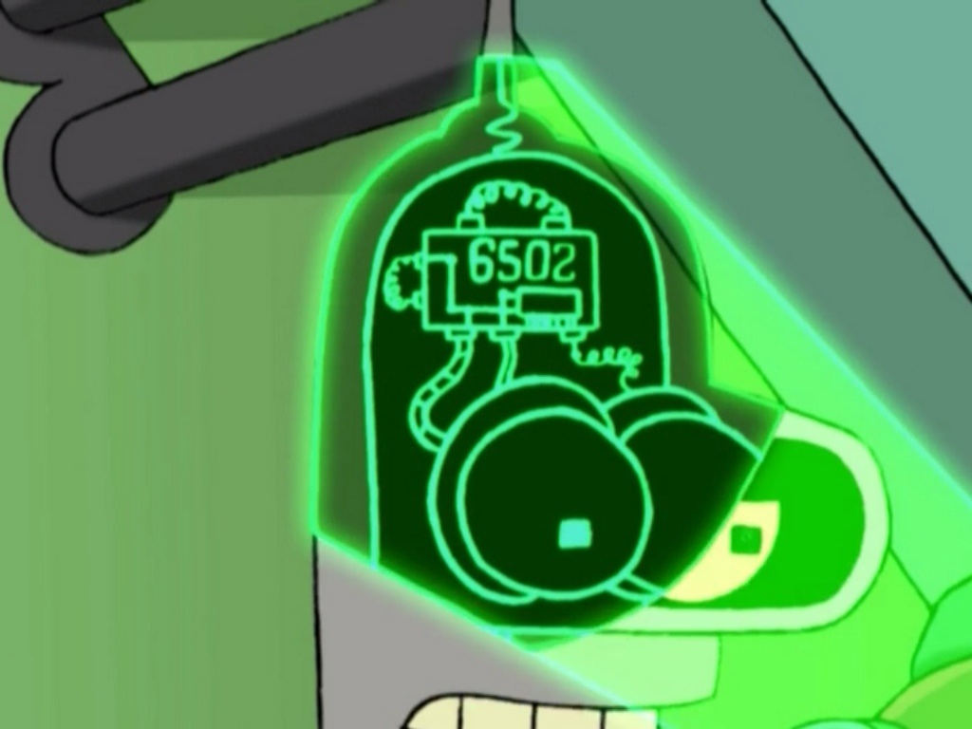


6502
Notes:
cheap Microprocessor, Motorola not interested
6800 team - Peddle - joined MOS Technology 1975
6501 - lawsuit
Mask Fixing – 30 -> 70% yield
6502 – RISC – 1mhz but instruction cycles
1975 trade show – vases of chips
Complete Product family
Kim-1
Uses PET, Apple 1 & 2, BBC Micro, Nintendo Entertainment System
Layout – crawling on tables - Visual 6502 – 3,510 transistors
Wilbur Mathys, Bill Mensch, Rodney Orgil, Ray Hirt, Chuck Peddle, Harry Bawcom, Michael Jaynes, Sydney-Anne Holt
,

Slide 21
6502
8-bit Commodore
Apple 1 & ][
BBC Micro
Nintendo NES
Atari
Bender
Cyberdyne Systems Model 101
Notes:
In “Fry and the Slurm Factory” – last season 1 episode

Slide 22
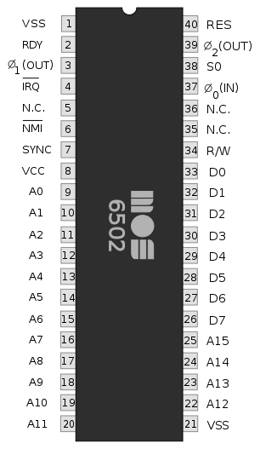
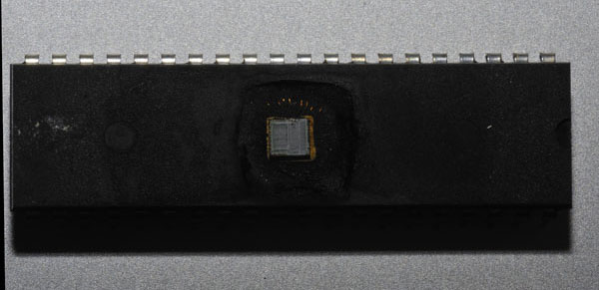
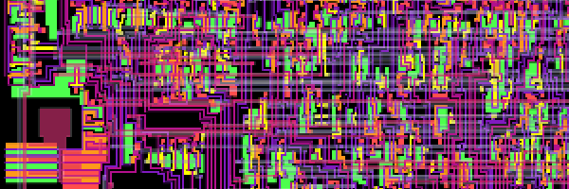
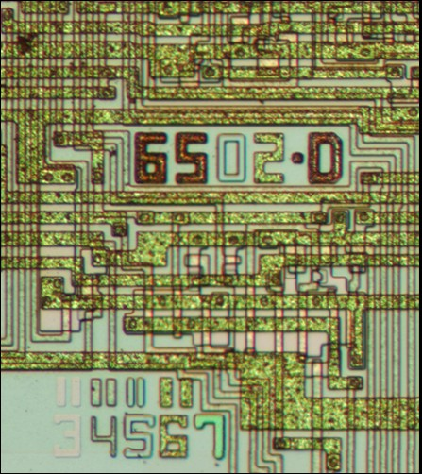
6502
Original designs lost
www.visual6502.org
6502 in action…
Notes:
In “Fry and the Slurm Factory” – last season 1 episode

Slide 23
“The 1977 Trinity”

Slide 24


Designed by John French / Leininger
3500 units in November 1977
Z-80 CPU
4k RAM & 4k ROM - $599 (Tiny Basic)
16k RAM, 12k ROM Level II - $1099
Expansion Interface for $299, disk drive for $500
Sold 250,000 worldwide
Discontinued due to FCC interference
Many further models

Slide 25
“The 1977 Trinity”

Slide 26

Designed by “The Woz”, colour and sound
Introduced June 10th 1977
6502 CPU,
Colour & Expansion slots, Disk ][ Interface
4k RAM - $1298
16k RAM - $1698
600 in 1977, 7600 in 1978, 35000 in 1979
Killer app, VisiCalc

