Slide 1
Diagnostic Hardware
PET
  Built in diagnostics on 2001
  The PETvet
VIC-20
  Commodore Diagnostic
C64 / C128
  Dead Test Cartridge (Really Useful)
  Other Diagnostic Cartridge
Plus/4, C16, C232
  Diag264

Slide 2
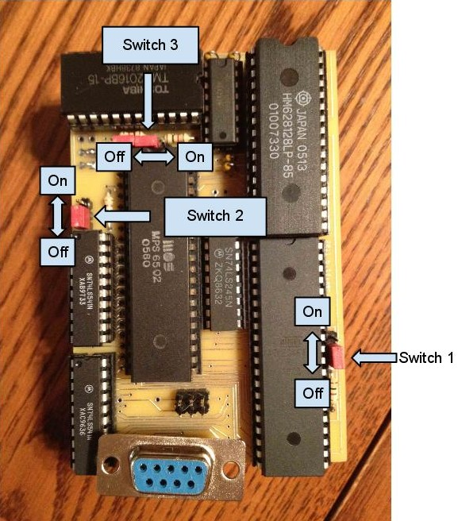
PETvet
Developed By Mike Hill
Programmable ROM/RAM replacement
Customisable Memory Maps
Reprogrammable by Serial port
Tools to halt CPU and view memory

Slide 3
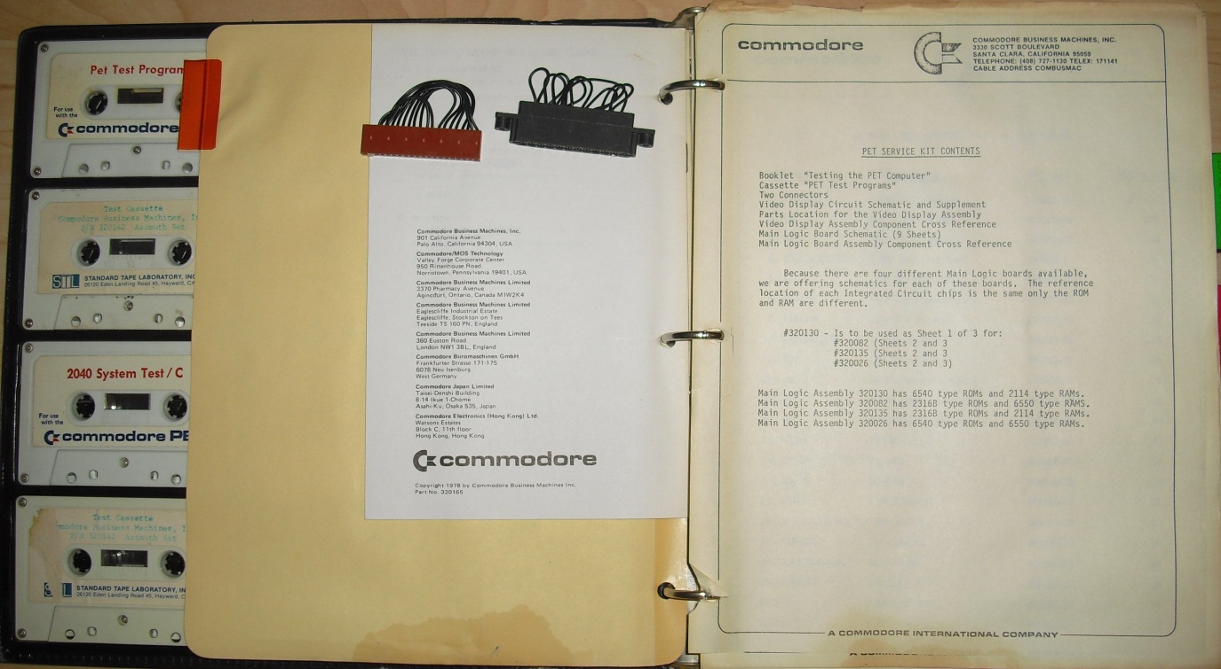
Other PET Tools
Built in diagnostics on Rev-1 ROM’s
LED on board 2001 series
Build a NOP generator
The 2001 Service Kit!

Slide 4
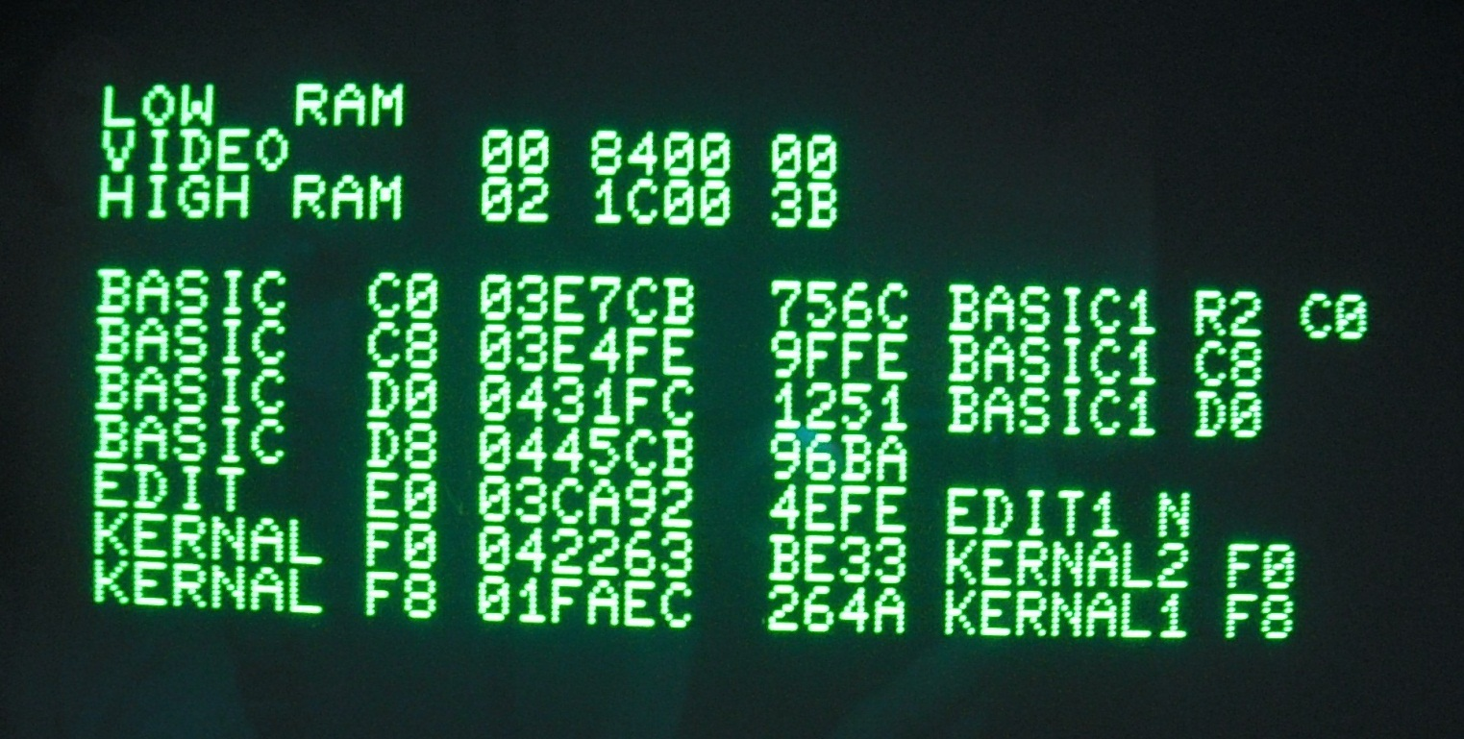
DiagPET / PETvet
Replaces the top 1k ROM (FC00-FFFF)
Installs ROM at A000 (normally unused)
Checks all RAM/ROM, including ZP/Stack

Slide 5
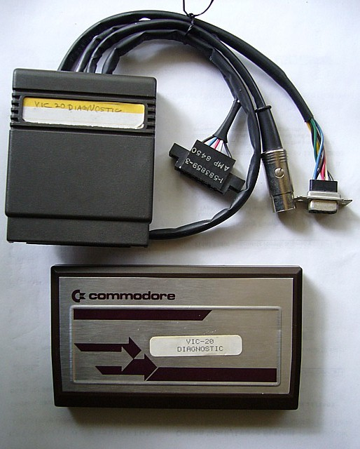
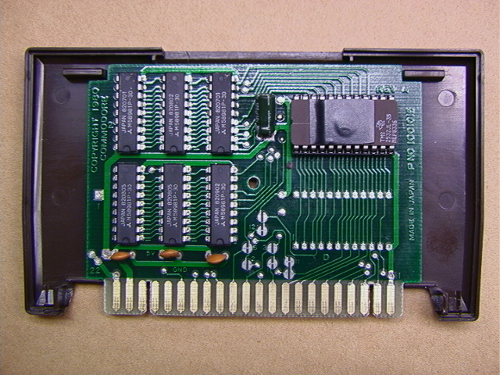
VIC-20 Diagnostic
Commodores own tool
External ROM with own RAM

Slide 6
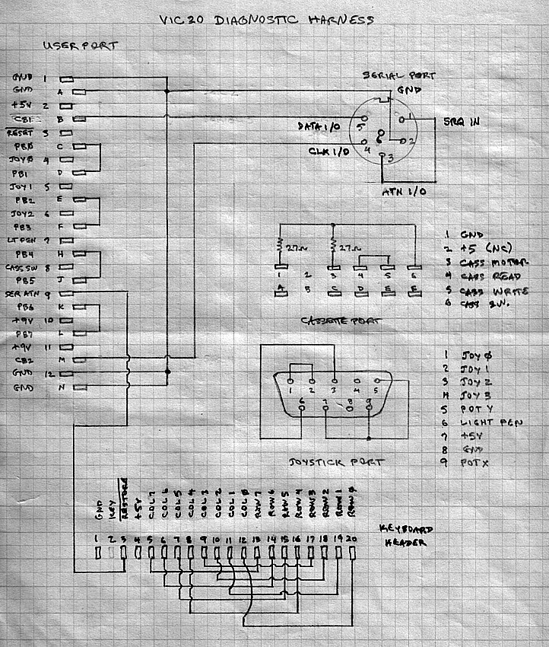
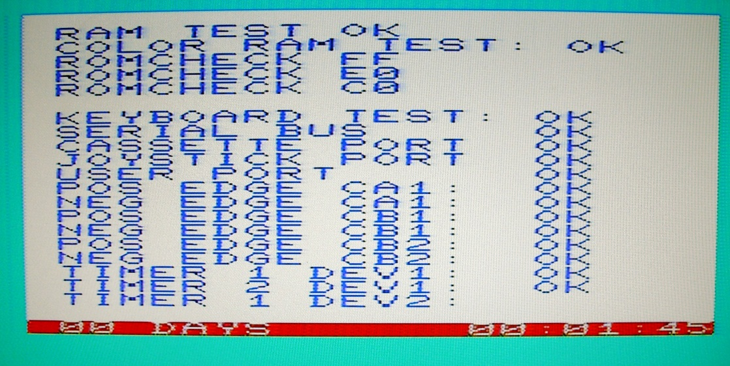
VIC-20 Diagnostic
RAM / ROM Checksums
Primarily for I/O
Loop Backs most ports
Picture Courtesy Ray Carlsen

Slide 7
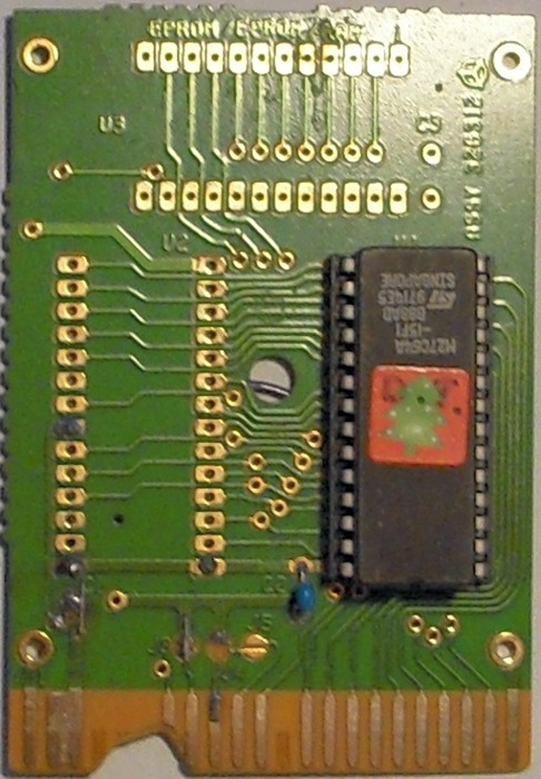
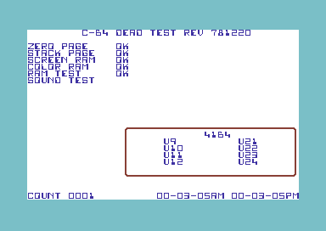
C64 / C128 – Dead Test Cart
Ultimax mode to bypass Kernal
Works with no RAM/ROM/SID or CIA’s
Uses border to indicate bad RAM

Slide 8
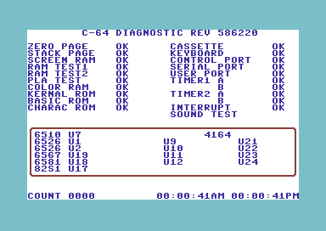
C64 / C128 – Diagnostic Cartridge
Needs a bootable machine
Like VIC cart, loops back I/O ports

Slide 9
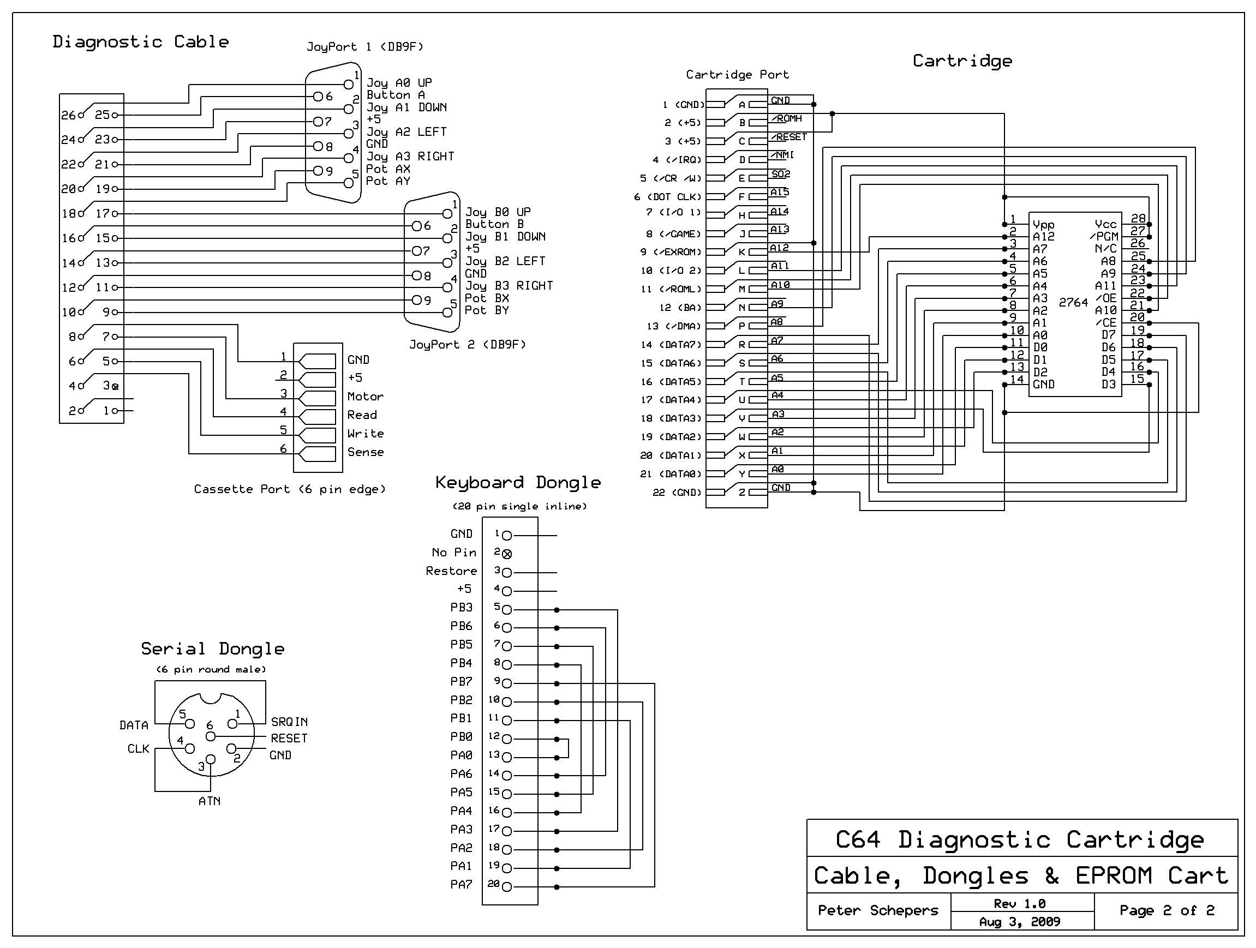
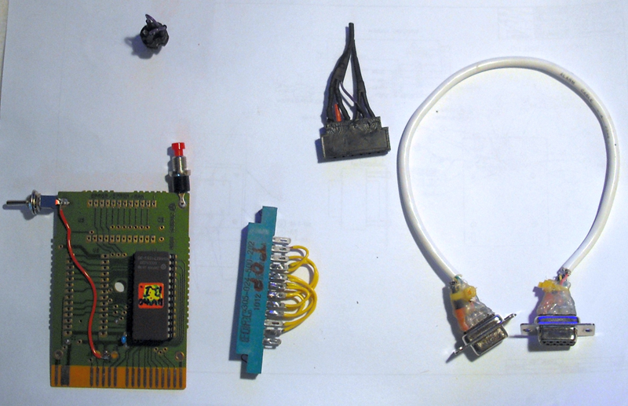
C64 / C128 – Diagnostic Cartridge
Easy to build your own
Schematics freely available, but over complicated!
C128 Version similar but untested by me.

Slide 10
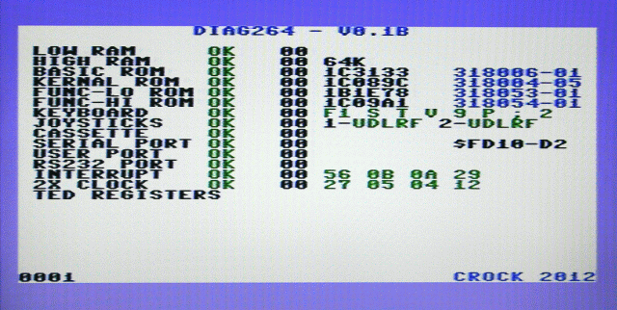
Plus/4, C16, C232 – Diag264
Built to fix a Commodore 232
Kernal or Cartridge based
Comprehensive testing of RAM/ROM & Ports

Slide 11
Common Culprits - PET
Mostly ROM & RAM
  6540 / 2316 adapters from Jim Brain
  2114’s and 4116’s still plentiful (later 2001’s
  6550’s are tricky!
Decoding Logic (use a NOP generator)
  Standard 74 series TTL
Occasionaly CPU or VIA’s / PIA’s, but rarely
  WDC Still makes 6502’s

Slide 12
Common Culprits – VIC 20
Reliable, mine all work today with no fixes!
ROM’s easily replaceable
RAM’s easily sourceable (2114’s, TMM2016)

Slide 13
Common Culprits – C64
64’s are cheap, so by implication…
Most commonly PLA (black screen)
…& SID (works but defective sound)
CIA’s are fragile but replaceable
For everything else, Ray Carlsen…

Slide 14
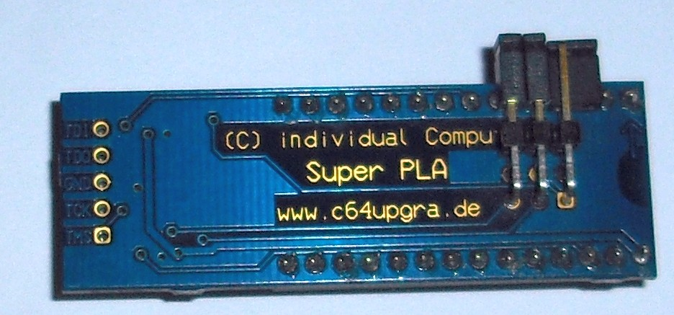
SuperPLA Multi
Created by Jens Schoenfeld
Extracted C64 PLA eprom image in 1994
Equations derived as part of C-One project
Implemented on a MACH210 modern PLA
Includes PLA’s from CBM-II’s, Plus/4, and 1551
Also includes modes not implemented on C128

Slide 15
Resources
PET
http://www.bitfixer.com/bf/petvet
http://www.6502.org/users/andre/petindex/index.html
http://www.zimmers.net/anonftp/pub/cbm/pet/index.html
http://www.vintage-computer.com/vcforum/forumdisplay.php?21-Commodore
VIC-20
http://sleepingelephant.com/ipw-web/bulletin/bb/index.php
C64, C128
http://www.retro-donald.de/pages/superpla-multi.php
http://www.swinkels.tvtom.pl/swinsid/
http://www.lemon64.com/
http://personalpages.tds.net/~rcarlsen/
Plus/4, C16, C232
http://inchocks.co.uk/commodore/Diag264/HTMLManual/Diag264.htm
http://plus4world.powweb.com/home
http://www.commodore16.com/index.php/forum.html
Spares
http://www.arcadecomponents.com/index.html
http://store.go4retro.com/
http://retro-donald.de/sinchai-shop/
General Info
http://www.softwolves.pp.se/misc/arkiv/
http://personalpages.tds.net/~rcarlsen/
http://www.zimmers.net/anonftp/pub/cbm/

